Slide 1
Further CSS and Intro to Bootstrap
Web Campaign Session 2
Subhajeet Lahiri
Vikas Kalyanapuram

Slide 2
CSS Position Attribute

Slide 3
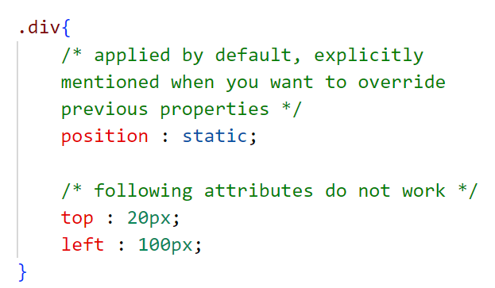
Static
Positioned in the order in which they are coded

Slide 4
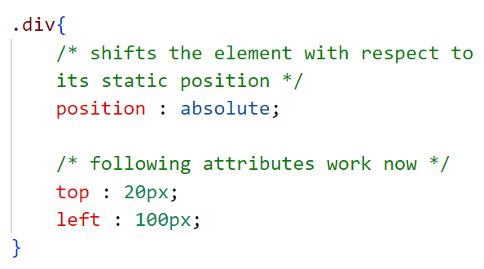
Relative
Translated relative to its static position

Slide 5
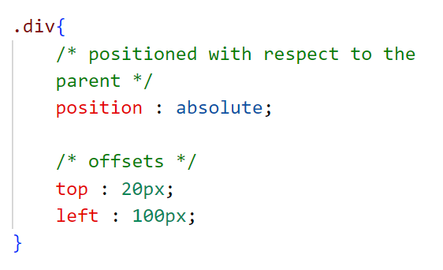
Absolute
Translated relative to its parent

Slide 6
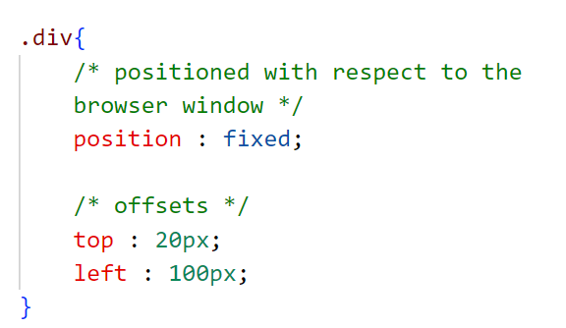
Fixed
Translated relative to the browser window

Slide 7
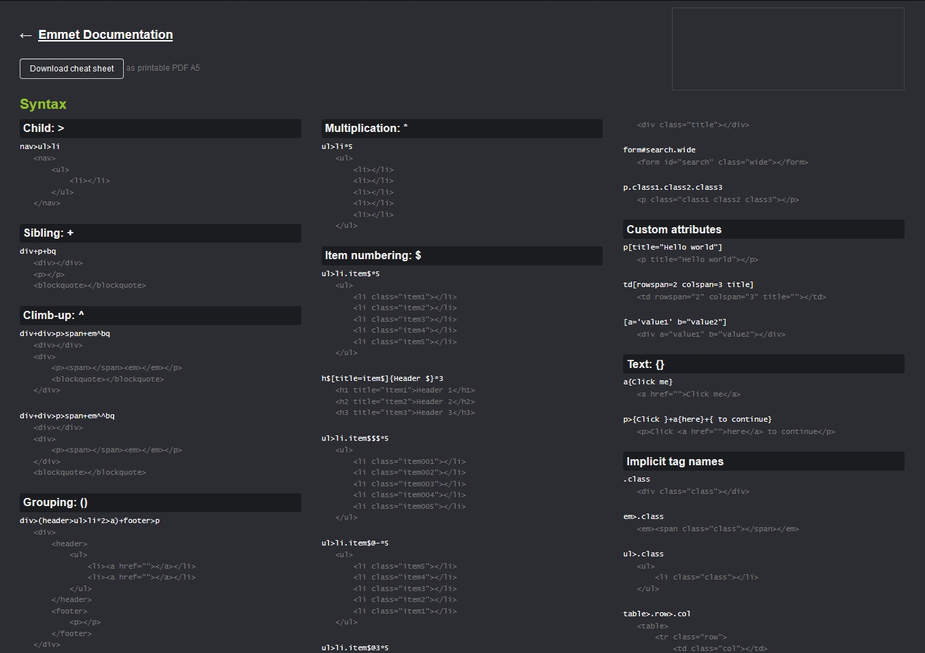
Emmet’s cool

Slide 8
Display Attributes

Slide 9
Block and Inline elements
The former takes up the entire available width and tolerates no elements beside it. The latter is displayed on the same line

Slide 10
Flex
Comes with a lot of perks
flex-direction : column , row-reverse …
flex-wrap : wrap, nowrap …
justify-content : flex-start, center, flex-end …
(main axis)
align-items : flex-start, center, flex-end …
(cross axis)

Slide 11
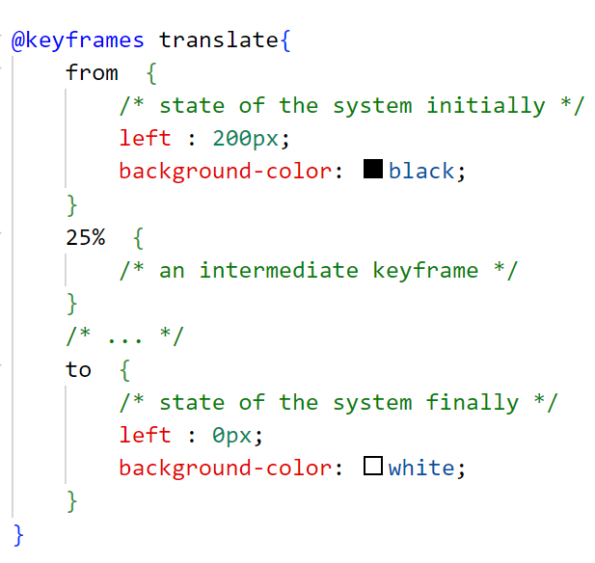
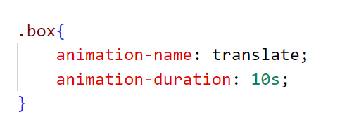
CSS Animations
Add some keyframes, the ones in between are added automatically

Slide 12
Responsiveness
and
Media Queries

Slide 13
What is Responsiveness?
A responsive web page is a web page that looks good on all screen sizes.
A responsive web design will automatically adjust for different screen sizes and view ports.
Responsive web design is very essential for creating a positive experience for users.

Slide 14
Media Queries
Media Queries allow you to apply CSS Styles depending on a specific property of the device, such as screen size.
Therefore, Media Queries allow you to change the entire layout of a website based on the screen size.

Slide 15
Relative Units
Viewport Units :
100vh is equivalent to 100% of the screen height.
Percentage Measure :
Attribute value is specified as a fraction of the parent’s value.
em and rem
The former to set attributes of an element wrt to that of its parent and the latter to set them wrt to that of the root element

Slide 16
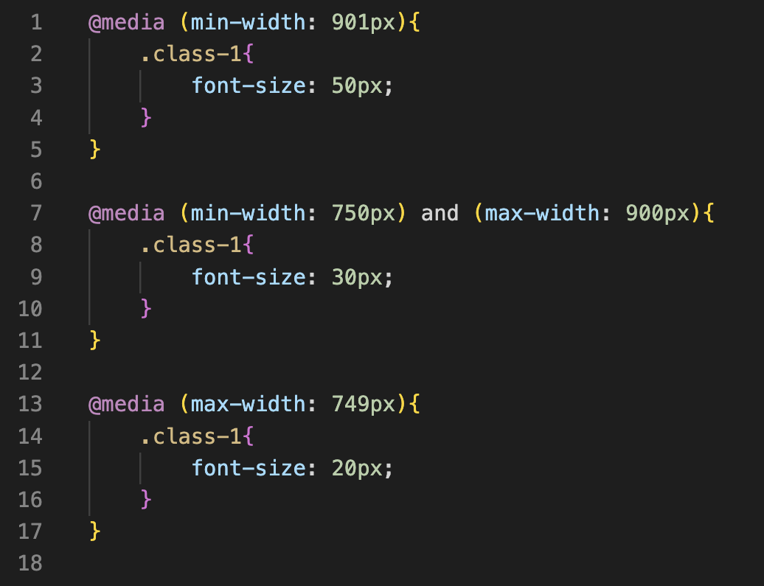

Slide 17

Bootstrap

Slide 18
Bootstrap
Free and Open Source CSS Framework that helps in building responsive web pages without writing too much code.
It provides certain class names which when added to html elements, causes them to be styled and/or positioned in a certain way.

Slide 19
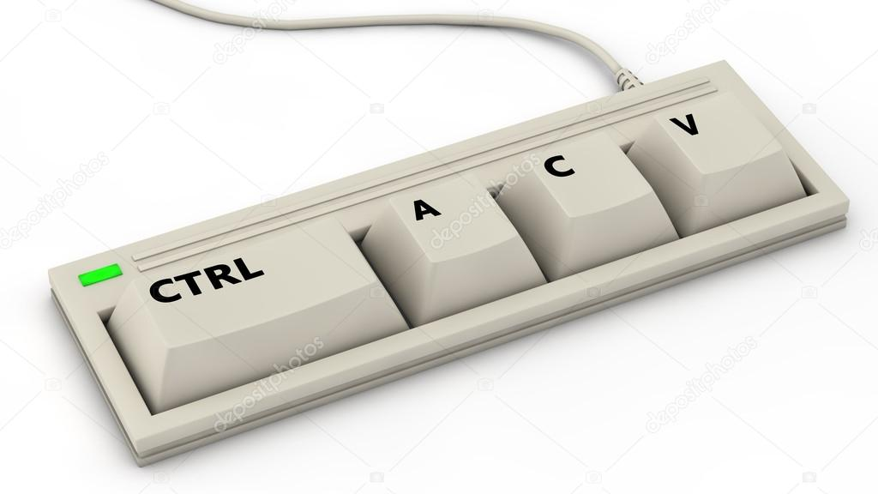
Documentation !!!!!!!
https://getbootstrap.com/
https://getbootstrap.com/docs/5.3/getting-started/introduction/
Notes:
Show button example in bootstrap

Slide 20
Bootstrap Container
Containers are a fundamental building block of Bootstrap . They contain, pad, and align your content within a given device or viewport.
Makes responsiveness much easier as container has inbuilt breakpoints (using media query) in the CSS.
https://getbootstrap.com/docs/5.0/layout/containers/

Slide 21
Grid System
Used within container
Divides the device viewport into twelve columns
Provides six default responsive tiers which allows us to align divs based on the device size.
https://www.w3schools.com/bootstrap4/bootstrap_grid_system.asp

Slide 22
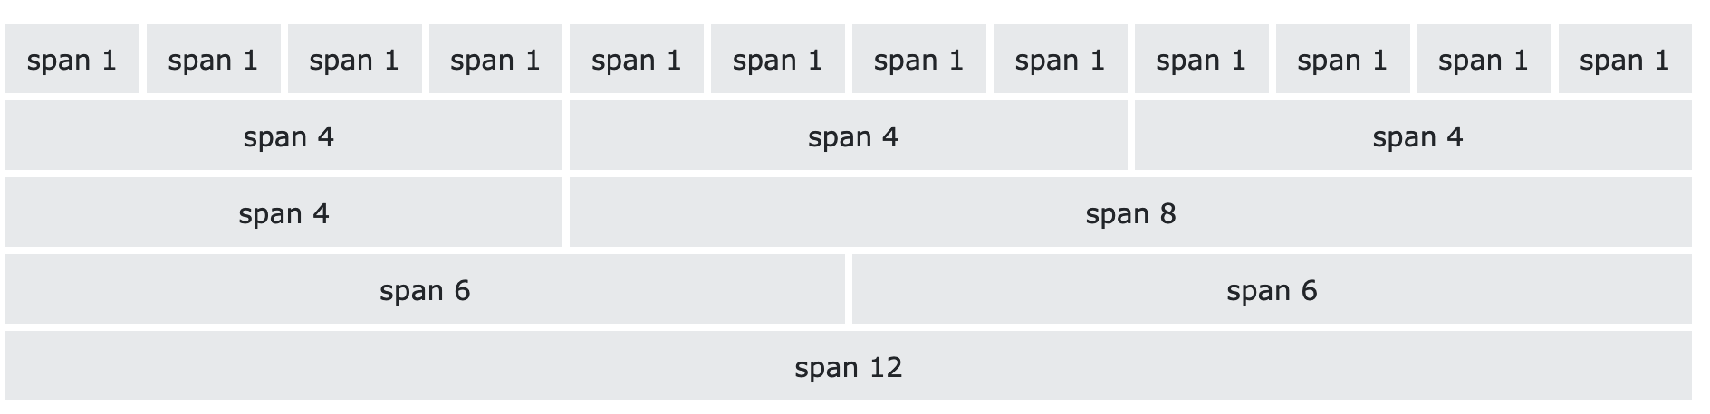
Notes:
After demo, show difference between container and container-fluid

Slide 23
Time to Put what We’ve Learnt to the Test !!
Notes:
Tell them about bootstrap cards

Slide 24
Thank You For Attending
Link to the Code :
https://github.com/LieutPaul/GDSC-Web-Session2

